Slide 1
Geo-Spatial-Temporal Visualization of Bank of Money
Visual Analytics 2012
Avgerinidis Liveris
Sagar Jaysinh
Steenbergen Nikolaas
Zervos John

Slide 2
Processing the Data
Python with Sqlite3
Creates local database file
Load csv files into Database
Merge meta and status data
Split into 1h files
Create index
Do queries, save results as csv

Slide 3
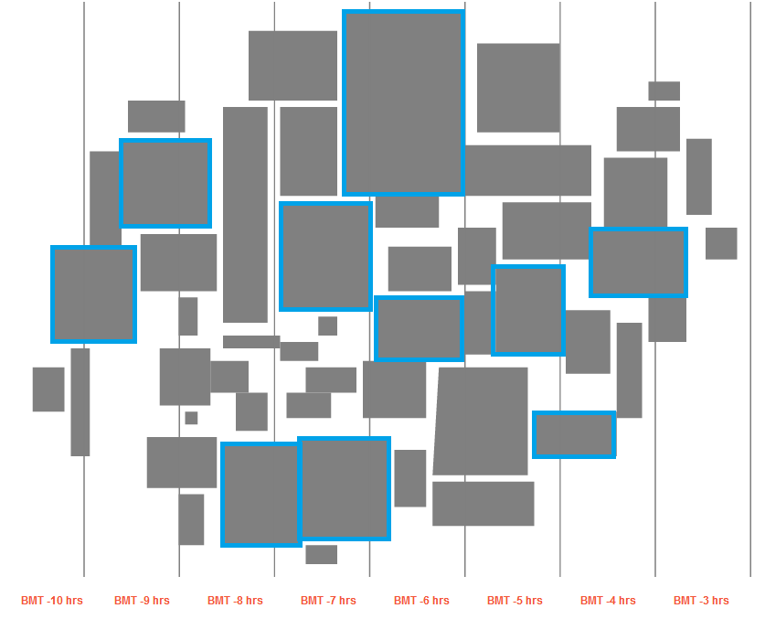
Bank of Money

Slide 4
Bank of Money
Contains 50 regions (10 large/40 small)
5 datacenters
Data for two 24-hours periods (192 timesteps of 15-minutes)
Total of 4056 locations
Around 900.000 different ips
Rules
Working hours Mon-Fri 7:00-18:00
Turn off workstations during the night
Maintenance is not taking place on a regular schedule

Slide 5
Visualization
D3 (Weka and Excel)
Using csv files from queries
Interactive Overview Visualizations (D3) for all 3 Days
  Geo vis
  Line graph
  Scatter plots
  Filtering mechanism and interaction
In depth data exploration with Excel and Weka

Slide 6
DEMO

Slide 7
Findings and Observations
Graph for first infected IP

Slide 8
Findings and Observations
Graph for Invalid Login Attempts
Graph for New Devices Added

Slide 9
Findings and Observations

Slide 10
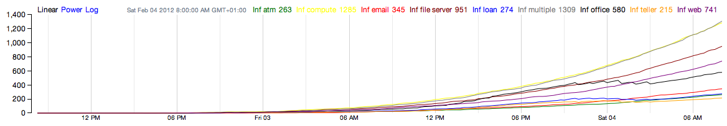
Findings and Observations
Spread of the Virus
Graph of Total number of infected machines

Slide 11
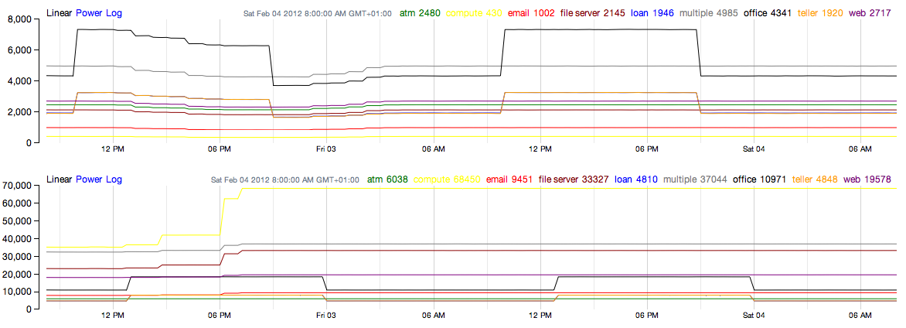
Findings and Observations
Disappearance of IPs
Graph of number of machines per class and timezone

Slide 12
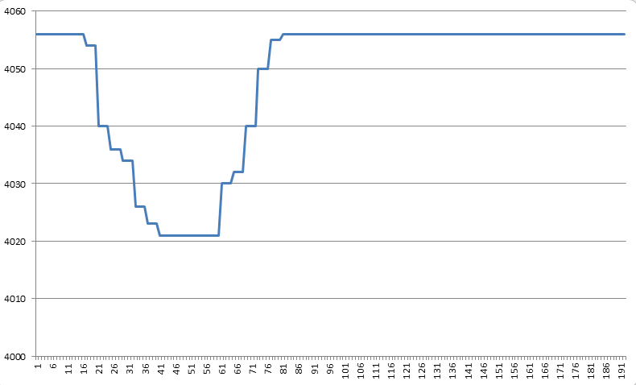
Findings and Observations
Disappearance of IPs

Slide 13
Findings and Observations
1. Start of Virus Infection and Spread
2. No strong correlation between # of connections and Policy Status
3. Virus spread and trends show us that data centers are affected first and this may contribute to spread of virus over other machine types
4. Contrary to Problem statement, lots of computers online at night with a significant amount of connections active
5. Not many computers are healed/turned off after reporting policy status 5

Slide 14
Findings and Observations
6. Means of virus spread may be due to connections made with regional data servers from client computers of the bank
7. Several locations inactive during work hours only to come back on at night
8. No significant drop in infected computers throughout the time-line
9. Different machine types have different rates of infection
10. Computers follow the maintenance routine throughout the time-line.

Slide 15
Thank you for listening
Questions/Suggestions?

